Slide 1

BIO-INSPIRED LEARNING ALGORITHM FOR PUPIL TRACKING WITH A DYNAMIC VISION SENSOR
Joseph Warren, Yufei Wu, Aldo Faisal
MEng Final Year Project Presentation 2019

Slide 2
WHY IS PUPIL-TRACKING IMPORTANT?
Pupil-tracking
Dynamic Vision Sensor
Event-based processing
Spiking Neural Networks
Results
Design
Pupil/gaze position used to decode ‘intention’
Oculomotor function retained despite injury/disability
Decoded intention used to control assistive technologies
Notes:
Why pupil tracking?

Slide 3
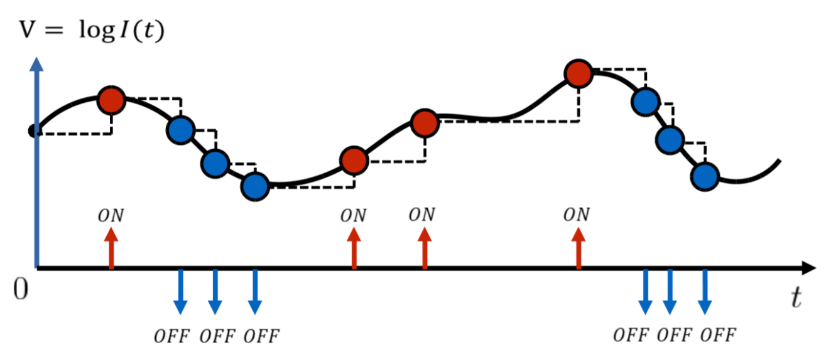
WHAT IS A DYNAMIC VISION SENSOR [DVS] ?
Pupil-tracking
Dynamic Vision Sensor
Event-based processing
Spiking Neural Networks
Results
Design
Pixels respond to relative changes in luminance
Sensitive to motion in visual scene
Output is asynchronous
Fast – μs precision
Similar encoding principle to retina
Spiking output
Relative changes
[1] Output (arrows) from a single pixel as luminance I(t) changes over time. ON represents increase in luminance, OFF represents decrease.
[1] Lichtsteiner P, Posch C and Delbruck T. A 128× 128 120 dB 15 μs latency asynchronous temporal contrast vision sensor. IEEE; 2008.
events stream
Single Pixel:
t
Notes:
What is a DVS?
New form of vision, very diff to traditional frame-based cameras (take successive snapshots)
Pixels code relative rather than absolute brightness
SHOW CAMERA NOW
Show no movement = no output
Movement = only edges (regions of change!)
Lights on/off -> no effect
Refer to figure -> ~brightness vs time for single pixel: if ~brightness inc then ON, else OFF
INSTANTANEOUS (asynchronous) response -> doesn’t wait for ‘clock cycle’
Really similar to retina -> continuous stream of spikes

Slide 4
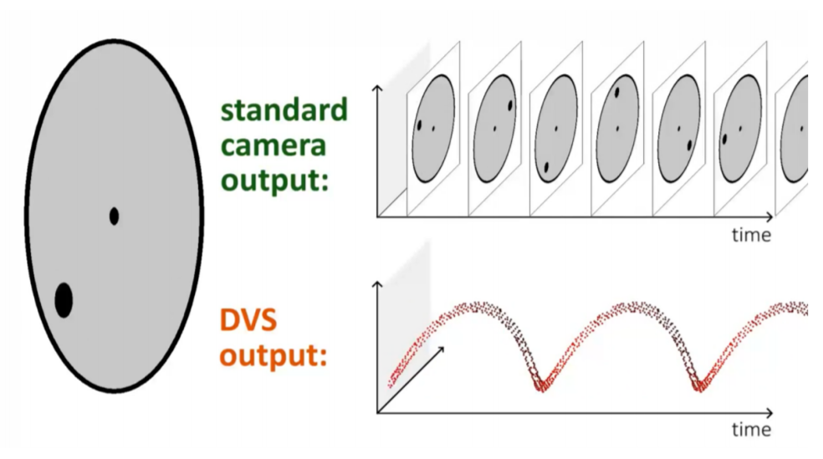
BENEFITS OF THE DVS
Pupil-tracking
Dynamic Vision Sensor
Event-based processing
Spiking Neural Networks
Results
Design
Benefits over frame-based vision:
Low latency
No motion artefacts
No redundancy in information
Effectively continuous sampling
Invariant to changing light conditions
[1] Spinning circle (left). Frame-based footage of spinning circle (top-right). DVS footage of spinning circle (bottom-right).
[1] Scaramuzza D. Tutorial on Event-based Vision for High-Speed Robotics. Lecture presented at; 2017; Robotics and Perception Group, University of Zurich
Notes:
What are the advantages?
Not waiting for a frame (which may be out-of-date anyway by time u receive)
If something moving fast
No wasted info since relative -> don’t care about static regions of vis space
Continuous stream ->no ‘BLIND’ spots betw frames (FIGURE)
Relative so inv to abs light level

Slide 5
WHY DVS FOR PUPIL-TRACKING ?
Pupil-tracking
Dynamic Vision Sensor
Event-based processing
Spiking Neural Networks
Results
Design
Never been done before!
Frame-based pupil-tracking typically limited to 30-120Hz
Control loops rely on sparse & out-of-date pupil-positions
DVS is rapid
Potential to track pupil with low latency and high sampling rate
Outcome
Faster control loops in subsequent assistive technologies
May observe eye-movements never seen before!
Notes:
Context of pupil-tracking
-Limited speed -> lag & between frames out-of-date info!

Slide 6
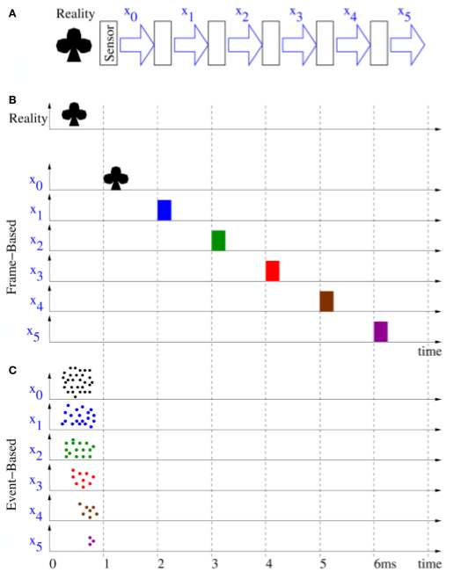
PROCESSING ASYNCHRONOUS DATA
Pupil-tracking
Dynamic Vision Sensor
Event-based processing
Spiking Neural Networks
Results
Design
Option 1: Accumulate events into frames (synchronous)
Image processing steps are sequential, therefore slow
Lose temporal precision
Option 2: Event-based processing (asynchronous)
Operate on events as they come
Leverages advantages of DVS!
[1] 5 stage image-processing pipeline (top). Frame-based processing – synchronous and sequential (middle). Event-based processing – asynchronous and simultaneous (bottom)
[1] Farabet C, Paz R, Pérez-Carrasco J, Zamarreño-Ramos C, Linares-Barranco A, Lecun Y, et al.. Comparison between frame-constrained fix-pixel-value and frame-free spiking-dynamic-pixel convNets for visual processing. Front. Neurosci. 2012; 6:32.

Slide 7
SUMMARY - BACKGROUND
DVS produces asynchronous output
DVS has many advantages over frame-based cameras
Ultrafast pupil-tracking is unchartered territory
Image-processing algorithms for DVS should be asynchronous
Notes:
Continuous stream of data
Mainly high temporal precision & low latency
Max 120Hz -> experimental potential & engineering potential
To take full advantage of DVS

Slide 8
SPIKING NEURAL NETWORKS: AN IDEAL SOLUTION
Pupil-tracking
Dynamic Vision Sensor
Event-based processing
Spiking Neural Networks
Results
Design
Network of neurons that communicate asynchronously
Used for image-processing in nature
Visual Cortex – remember parallels between DVS and retina!
Neural networks adept at complex pattern-recognition tasks
Often outperform traditional image-processing algorithms
Ideal for pupil detection from DVS data
Notes:
Neurons communicate independently with spikes

Slide 9
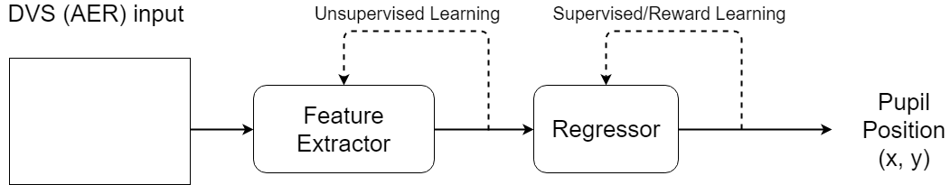
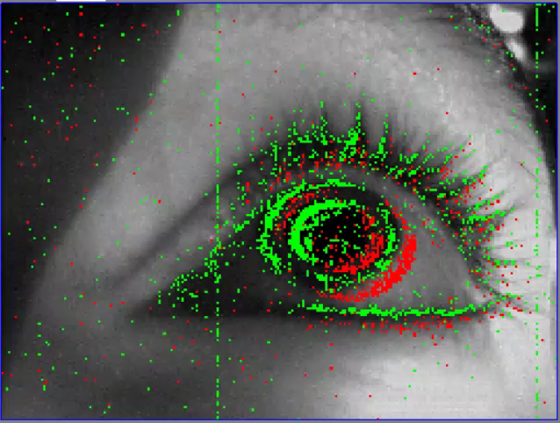
FORMALISING THE PROBLEM
Pupil-tracking
Dynamic Vision Sensor
Event-based processing
Spiking Neural Networks
Results
Design
Task: Learn mapping from DVS input data to pupil-positions
Feature extraction
Represent input in sparse code
Regression
Map sparse features to a known target

Slide 10
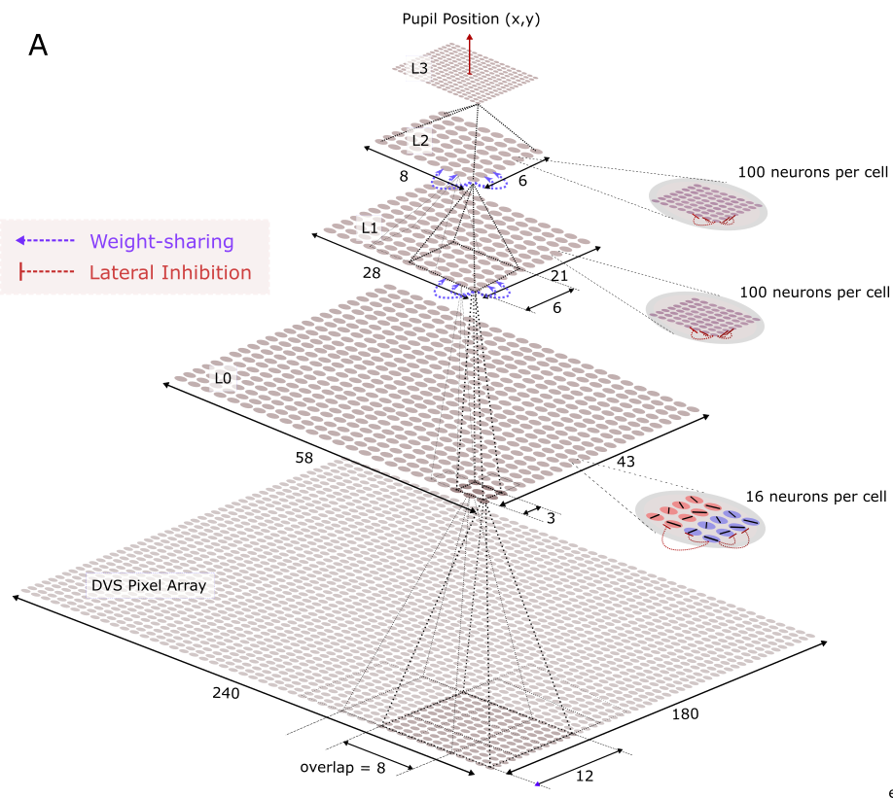
DESIGN
Pupil-tracking
Dynamic Vision Sensor
Event-based processing
Spiking Neural Networks
Results
Design
Hierarchical structure
Similar to visual cortex
Retinotopic organisation
With weight-sharing
Population code output
Unsupervised learning rule [Feature Extraction]
STDP
Innovative reward-based learning rule [Regression]
R-STDP
Biologically inspired
Previous SNN work focused on supervised learning

Slide 11

TEST EXPERIMENT
Pupil-tracking
Dynamic Vision Sensor
Event-based processing
Spiking Neural Networks
Results
Design
Test experiment to verify components of pipeline (feature extraction & regression)
Synthetic event data of moving circle
Circle speed & size roughly same as pupil during saccade
Video approximately 0.02x speed. Green pixels = ON, Red pixels = OFF.

Slide 12

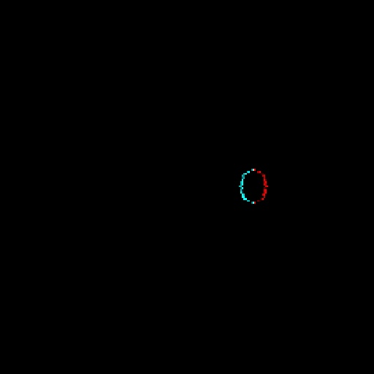
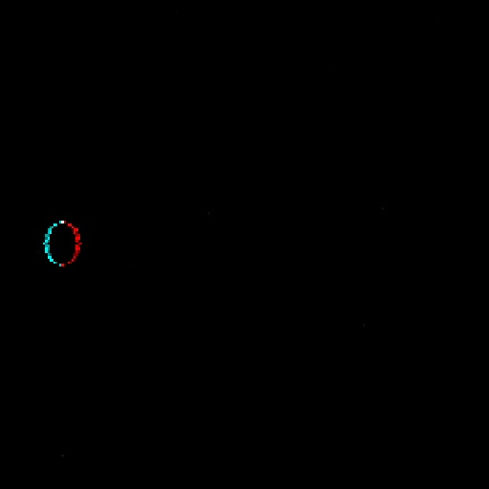

TEST EXPERIMENT – FEATURE EXTRACTION
Pupil-tracking
Dynamic Vision Sensor
Event-based processing
Spiking Neural Networks
Results
Design
Training
Neuron 1
Fully connected layer of neurons
Learn with unsupervised learning (STDP)
Neurons learnt selectivity to unique features
Neuron 2
Neuron 3
…
…
Preferred features before learning
Preferred features after learning

Slide 13
TEST EXPERIMENT – REGRESSION
Pupil-tracking
Dynamic Vision Sensor
Event-based processing
Spiking Neural Networks
Results
Design
Training
Fully connected layer of neurons
Population code
Each neuron assigned a ‘preferred’ circle centre position
Learn with reward-modulated learning (R-STDP)
Neurons learnt to respond only to their preferred position

Slide 14
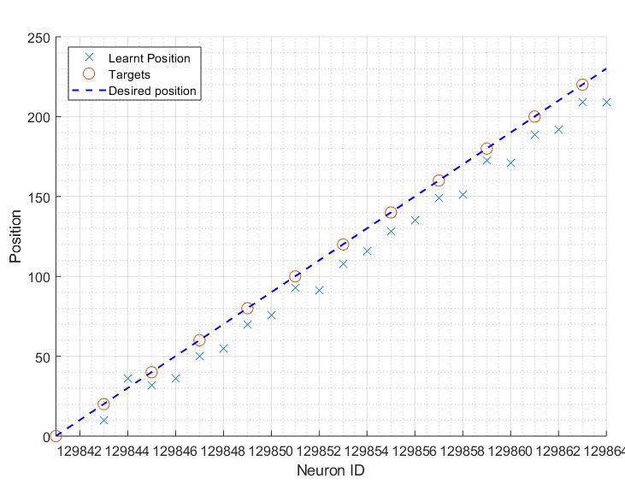
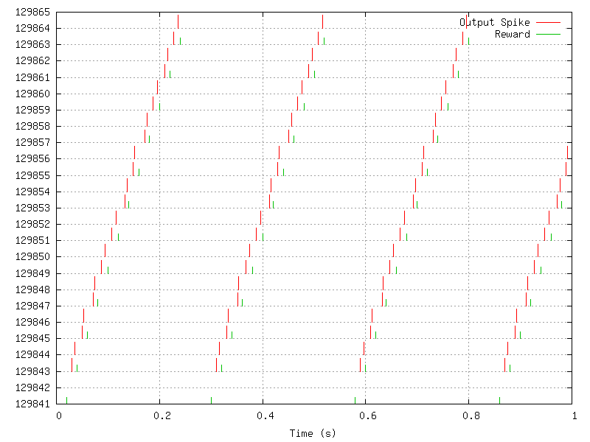
TEST EXPERIMENT – REGRESSION
Pupil-tracking
Dynamic Vision Sensor
Event-based processing
Spiking Neural Networks
Results
Design
Training
Raster plot of neuron responses & correct responses
Learnt position selectivity of neurons

Slide 15
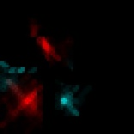
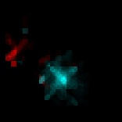







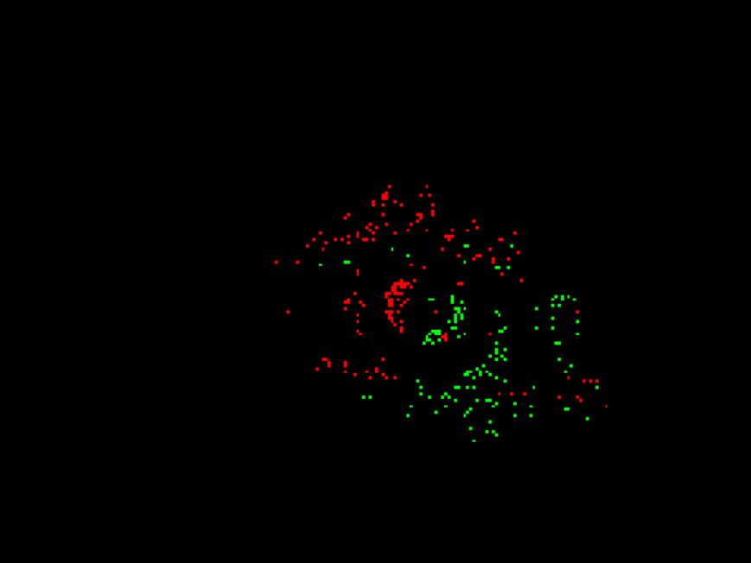











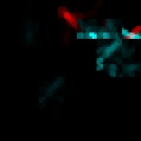








FEATURE EXTRACTION FROM PUPIL DATA
Pupil-tracking
Dynamic Vision Sensor
Event-based processing
Spiking Neural Networks
Results
Design
Training
Subset of preferred features of neurons at different layers
Blue = ON, Red = OFF
DVS: sample 2ms time-slice (240x180 pixels)
Layer 1 (12x12 pixels)
Layer 2 (20x20 pixels)
Layer 3 (60x60 pixels)

Slide 16
CONCLUSION
Pupil-tracking
Dynamic Vision Sensor
Event-based processing
Spiking Neural Networks
Results
Design
Training
Implemented our reward-based learning rule as a viable way to track an object from event-data
Implemented STDP for feature extraction from event-data
Architecture runs at real-time speed
Could expand architecture by simulation on specialised hardware

Slide 17
Any Questions

Slide 18
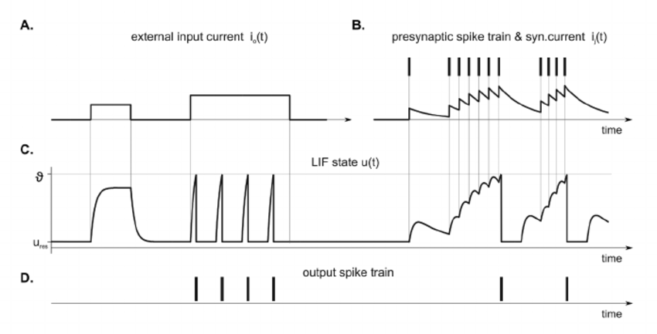
LIF NEURON
A: External driving current
B: Presynaptic spike train & resulting synaptic current
C: Membrane potential u(t) of LIF neuron. ϴ and u_{rest} denote spike threshold and resting potential.
D: Output spike train of LIF neuron
[1] Ponulak F, Kasinski A. Introduction to spiking neural networks: Information processing, learning and applications. Acta neurobiologiae experimentalis. 2011; 71 (4): 409.

Slide 19
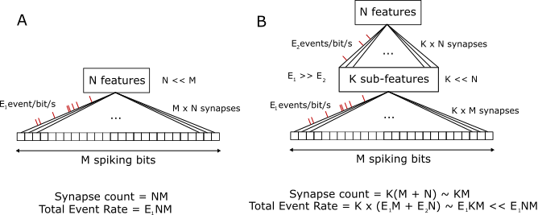
THE BASIS FOR HIERACHICAL FEATURE EXTRACTION

Slide 20
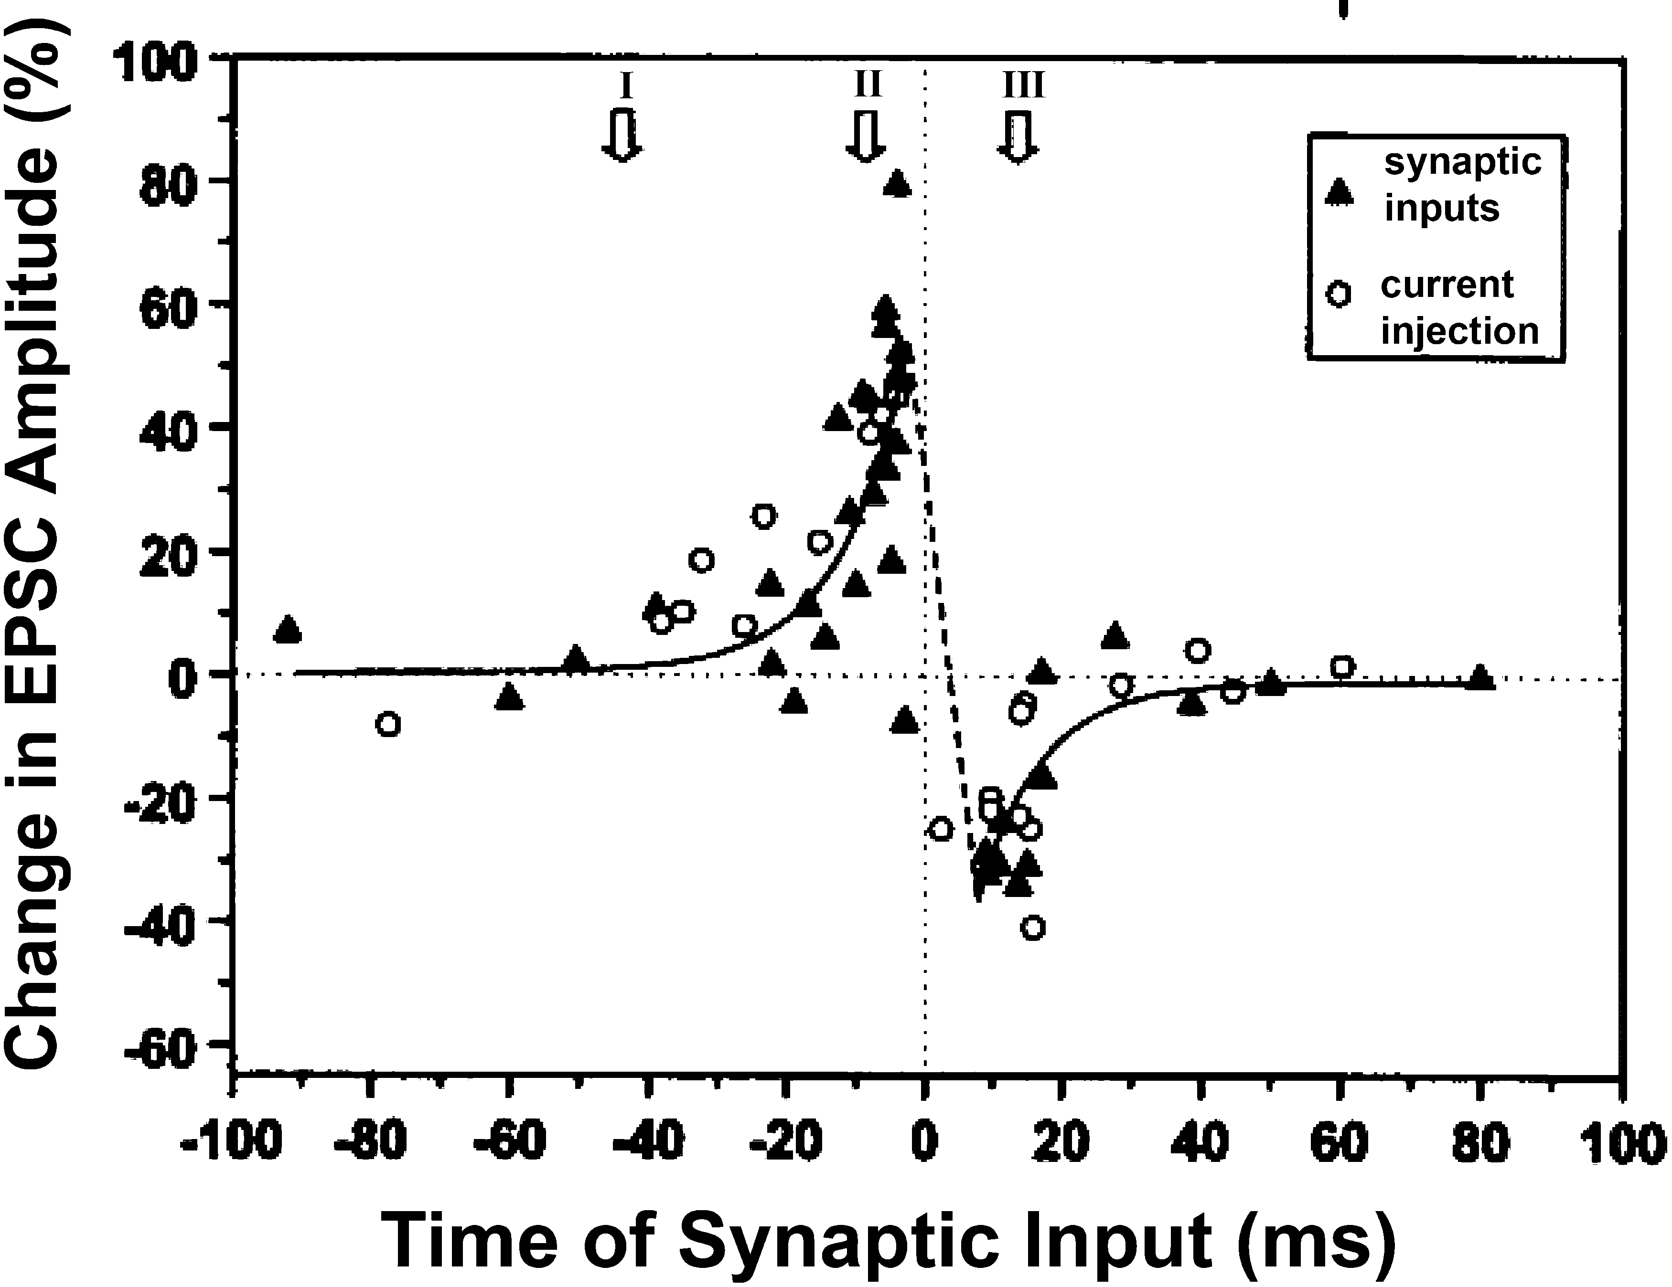
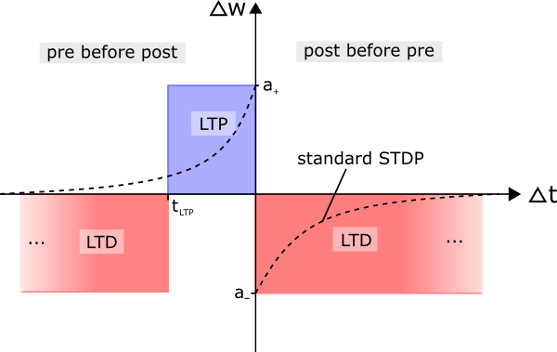
UNSUPERVISED LEARNING [STDP]
[1] STDP synaptic learning in Rat Hippocampal Cells
Simplified STDP rule used in this study
[1] Dan Y, Poo MM. Spike timing-dependent plasticity of neural circuits. Neuron. 2004; 30;44(1):23-30

Slide 21
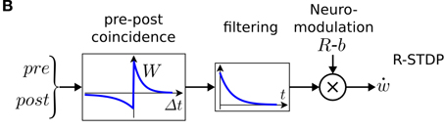
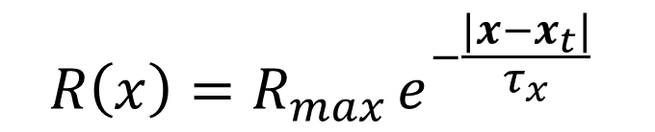
REWARD-MODULATED LEARNING [R-STDP]
[1] R-STDP process: STDP weight update is filtered by exponentially decaying eligibility trace, before reward modulation.
$$R\left(x\right)=R_{max }e^{−\frac{|x−x_{t}|}{τ_{x}}}$$
[1] Frémaux N, Gerstner W. Neuromodulated Spike-Timing-Dependent Plasticity, and Theory of Three-Factor Learning Rules. Frontiers in neural circuits. 2015; 9 85.

Slide 22
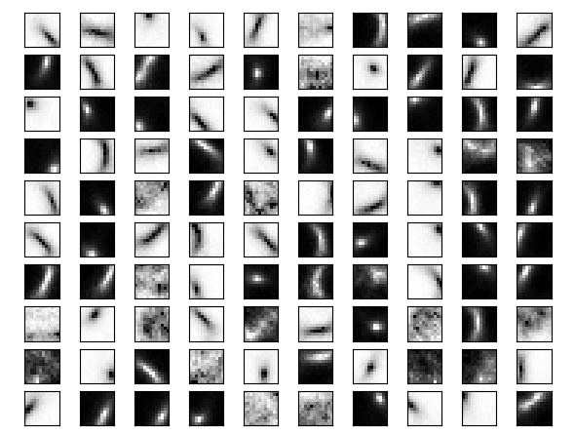
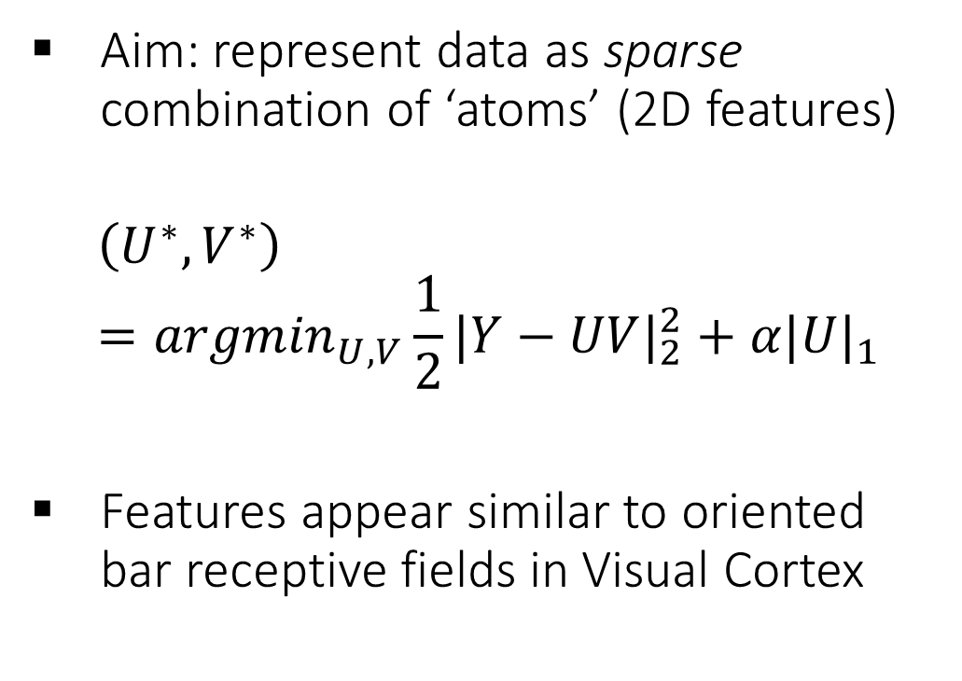
SPARSE-CODING FOR L1 FEATURES
Aim: represent data as sparse combination of ‘atoms’ (2D features)
$$\left(U^{∗},V^{∗}\right)={argmin}_{U,V}{\frac{1}{2}{|Y−UV|}_{2}^{2}+α{|U|}_{1}}$$
Features appear similar to oriented bar receptive fields in Visual Cortex

Slide 23
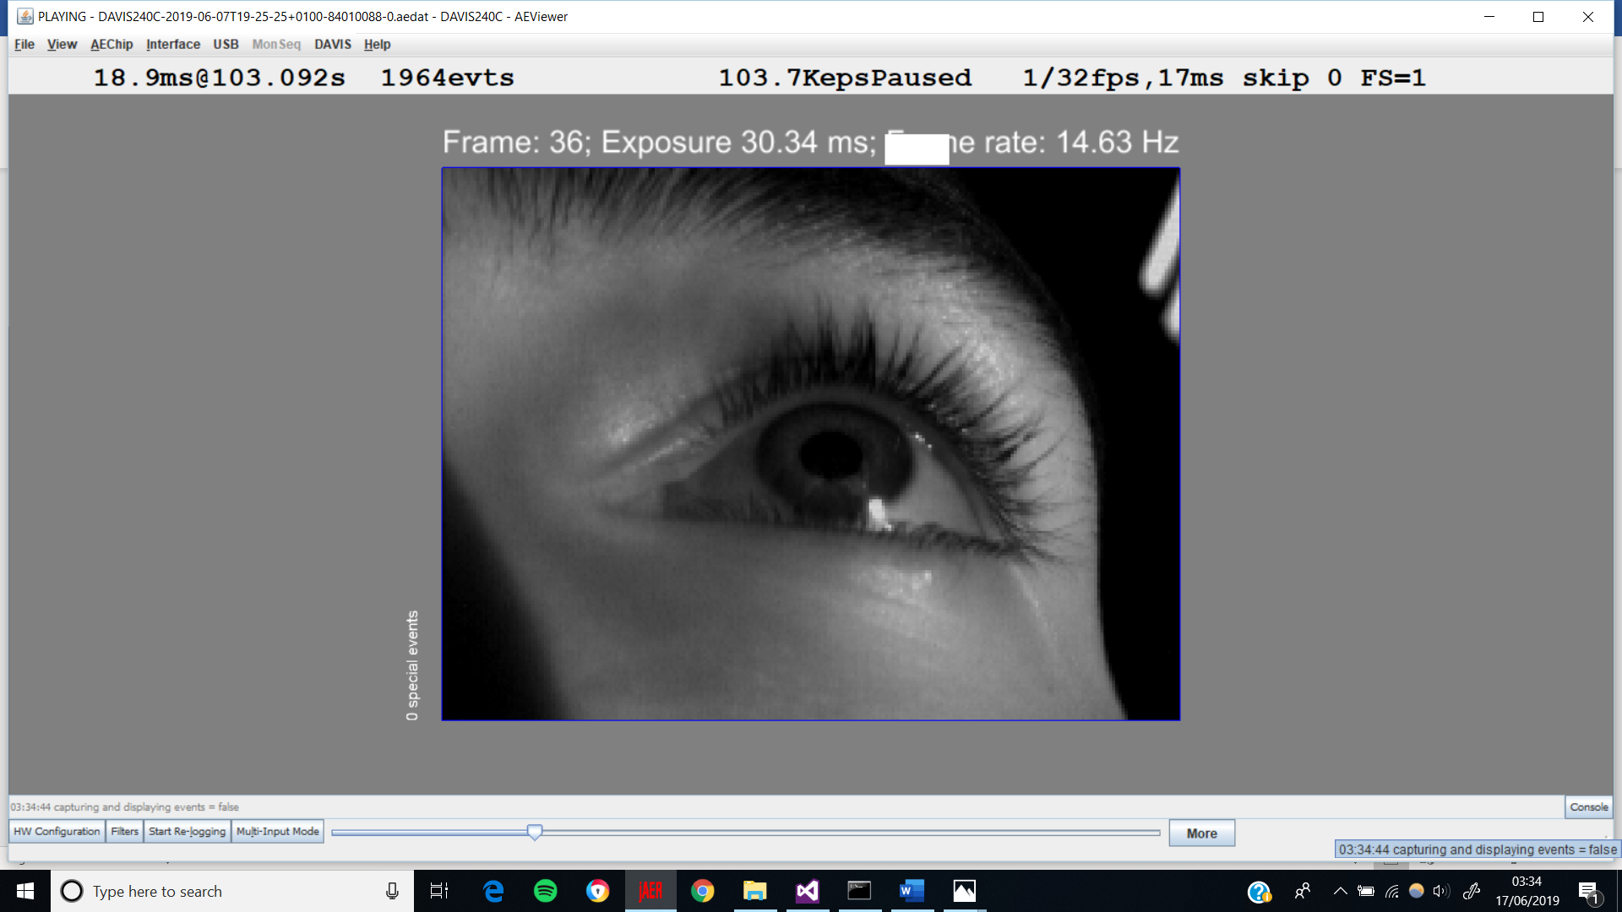
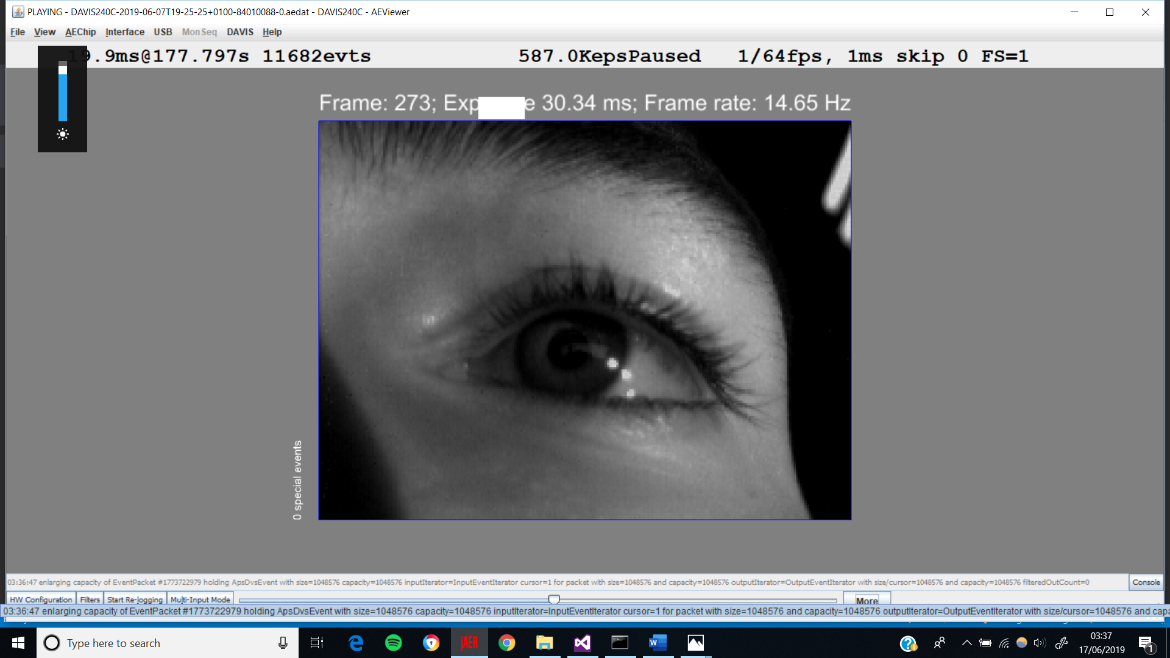
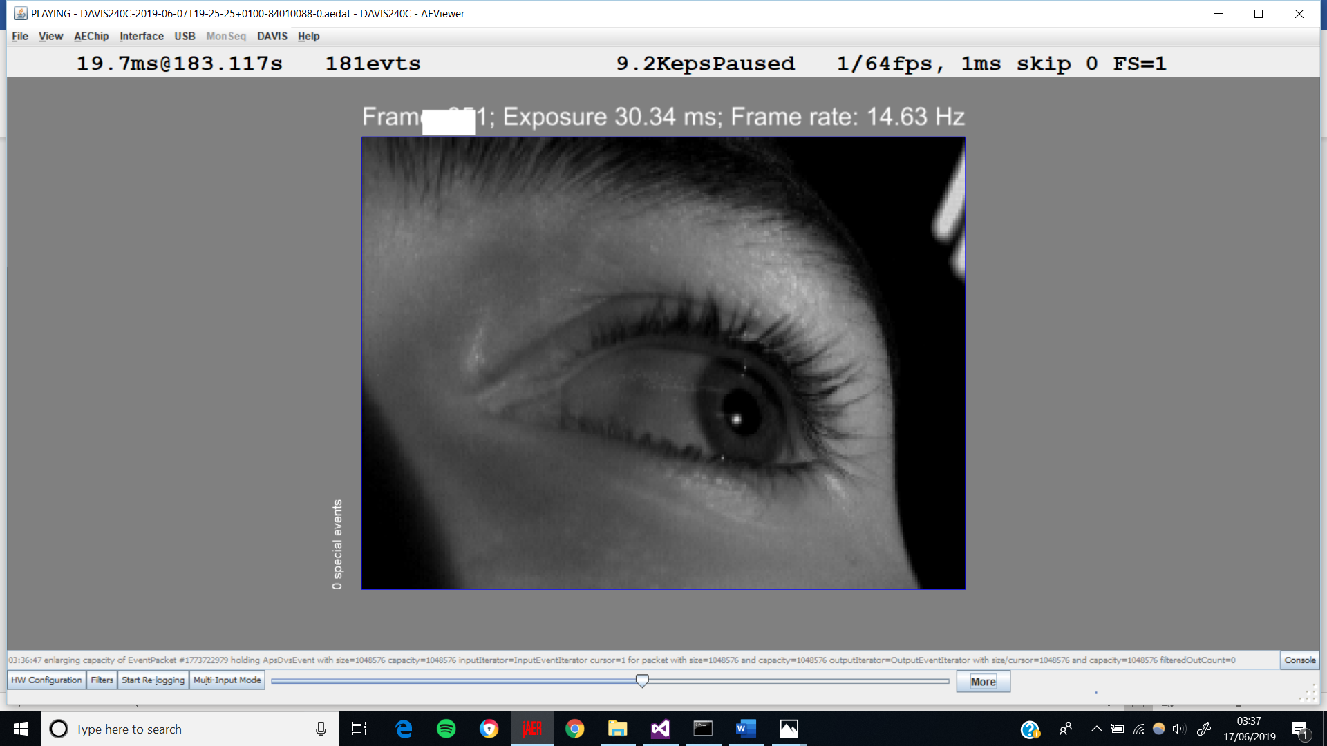
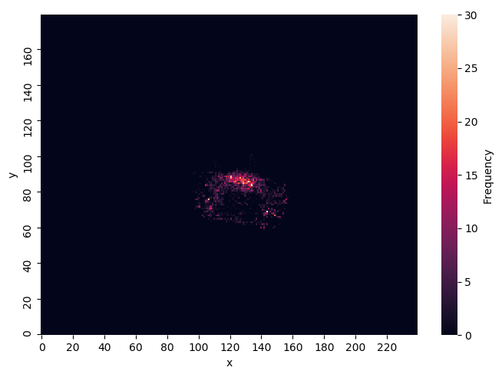
DATASET
Distribution of target pupil-positions in training dataset

Slide 24
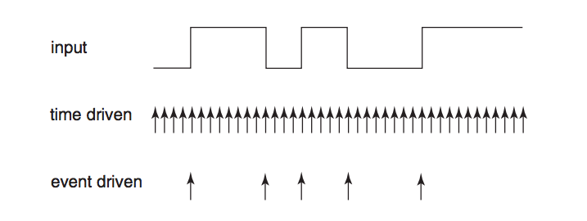
SIMULATION
Source: Short K. VHDL for Engineers. Pearson Education (2009)

